Slide 1

Self Balancing robot
Presented By : The Assembly Team

Slide 2
Why make it?
It is a really fun and interesting project to partake in, and easy to implement as well.
Applications :
Balancing a 2 wheel robot by itself
Navigating the robot using a mobile app.

Slide 3
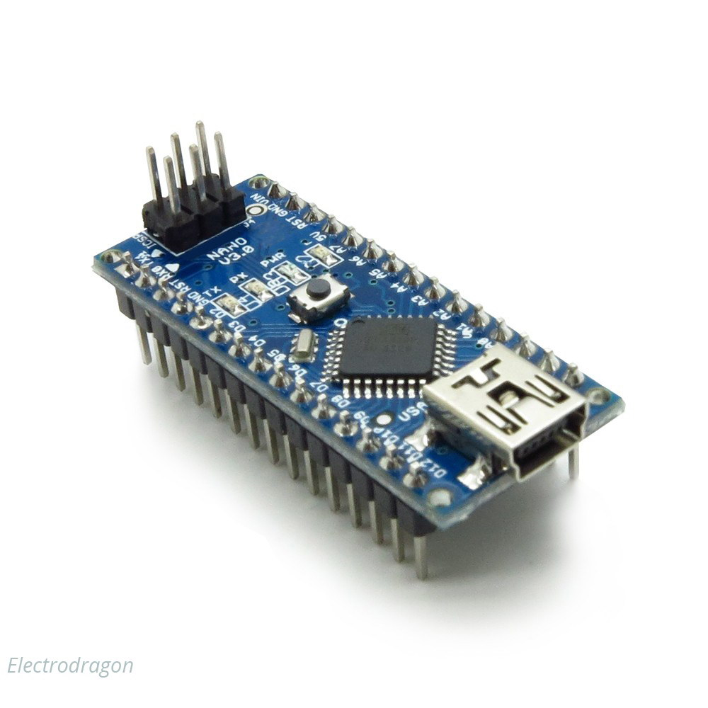
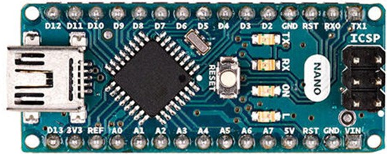
Arduino NANO
Notes:
The Arduino Nano is a small, complete, and breadboard-friendly board based microcontroller
Nano has two extra analog pins
Good replacement for uno as it is breadboard friendly

Slide 4
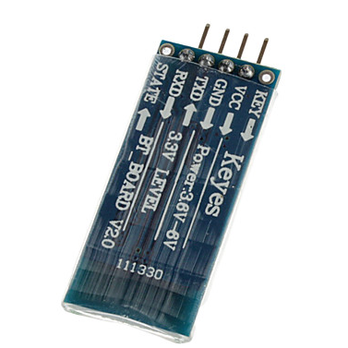
HC062 (Bluetooth module)
Notes:
*The HC-06 acts as a serial port through which you can send and receive data.
*So using a serial terminal or a Bluetooth customized application on your computer or phone, you can control and monitor your project.
*HC06 functions only as slave to a microcontroller

Slide 5
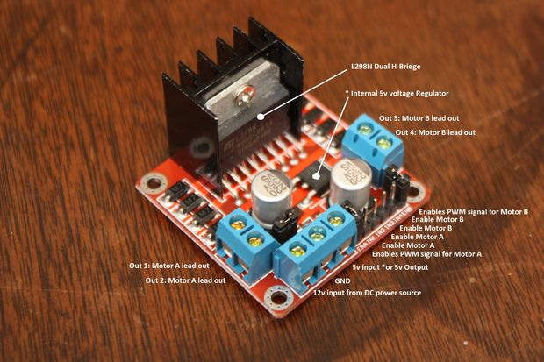
L298N (motor drive)
Notes:
*L298N Dual H-Bridge Motor Controller module
*H-Bridge's are typically used in controlling motors speed and direction, but can be used for other projects such as driving the brightness of certain lighting projects such as high powered LED arrays.
*An H-Bridge is a circuit that can drive a current in either polarity and be controlled by *Pulse Width Modulation (PWM)
*Pulse Width Modulation is a means in controlling the duration of an electronic pulse
*Motors are rated at certain voltages and can be damaged if the voltage is applied to heavily or if it is dropped quickly to slow the motor down.
* The longer the pulses the faster the wheel will turn, the shorter the pulses, the slower the water wheel will turn.

Slide 6
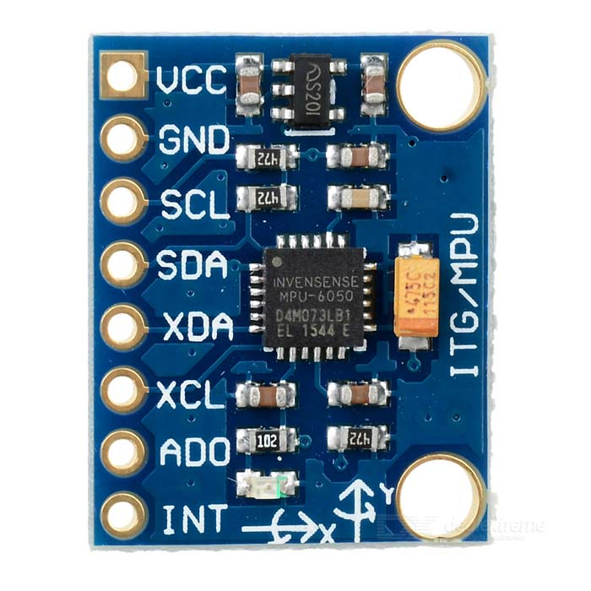
MPU6050 (Gyroscope & Accelerometer)
Notes:
*The MPU-6050 is not expensive, especially given the fact that it combines both an accelerometer and a gyro.
Therefor it captures the x, y, and z cordinates at the same time.
The MPU-6050 always acts as a slave to the Arduino with the SDA and SCL pins connected to the i2C
Ad0 meant to access complex functionalities for the i2c programming but in our case we are grounding it.
The interupt pin of mpu6050 helps the microcontroller know that fresh data has been arrived in the register which can be read by the controller.

Slide 7
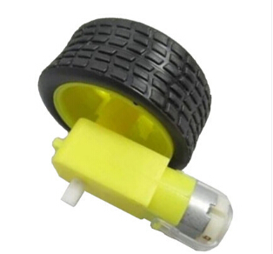
Geared DC motor
Notes:
*A gear motor is a specific type of electrical motor that is designed to produce high torque while maintaining a low horsepower, or low speed, motor output.
They do so Gear motors are primarily used to reduce speed in a series of gears, which in turn creates more torque.
*used in devices such as can openers, garage door openers, washing machine time control knobs and even electric alarm clocks.
*

Slide 8
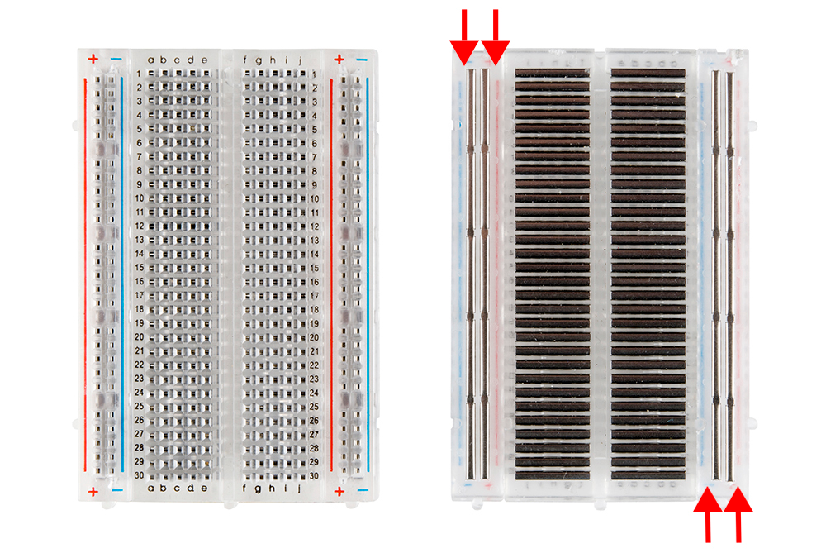
BreadBoard

Slide 9
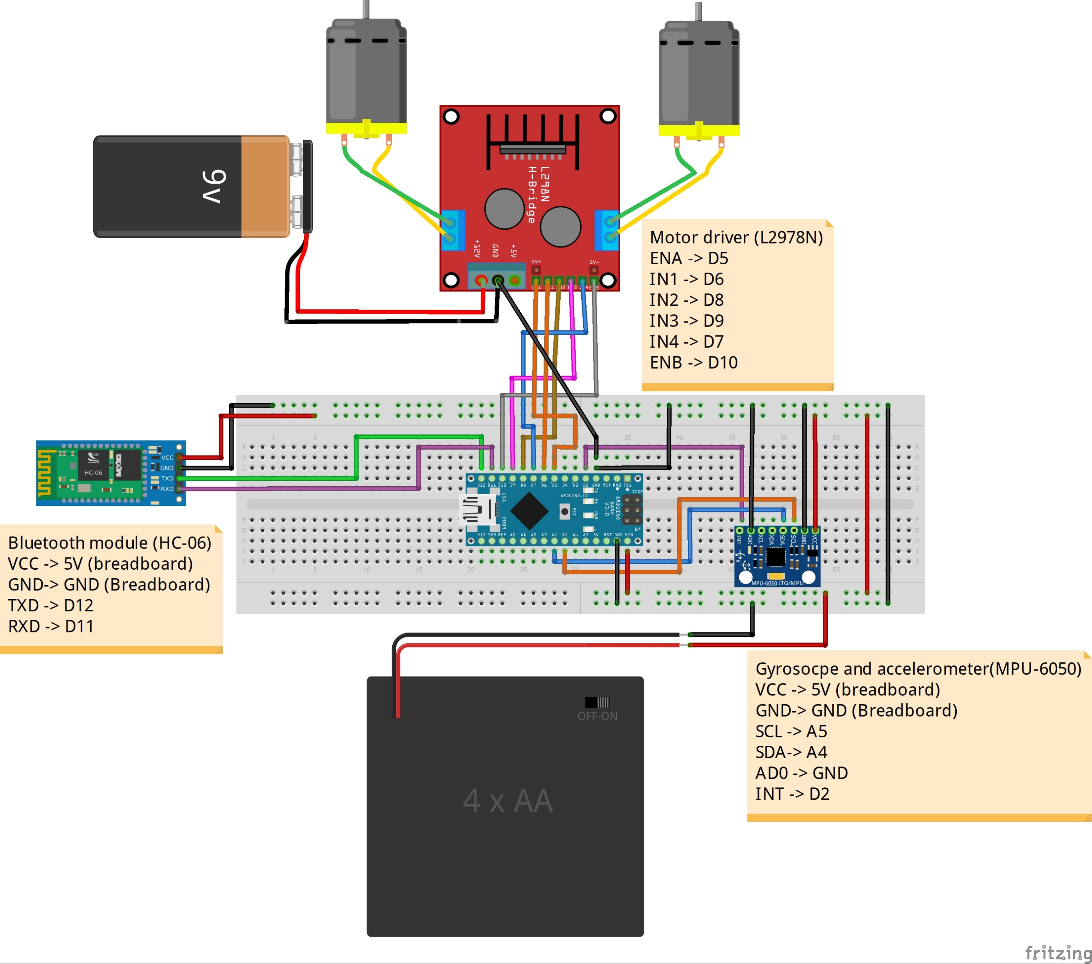

Slide 10
Testing the system
Download the Arduino IDE
Download the Arduino code, app code (.aia) and libraries file from: https://github.com/SuhailKhazi/SelfBalancingRobot/tree/Libraries
Put the library file in the following path in your PC: C:\Program Files (x86)\Arduino\libraries

Slide 11
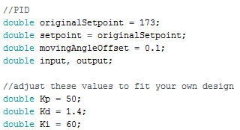
Self Balancing
Once all the parts are fixed according to schematic, upload the Arduino code.
If the system runs, then fix the components on the chassis appropriately.
Control the following parameters in the Arduino code to ensure the robot self balances: originalSetPoint, movingAngleOffset as well as Kp, Ki and Kd values.
originalSetPoint: the angle of the Gyroscope in which the robot is stable.
movingAngleOffset: amount of angle tolerance plus or minus the setpoint.
Kp: this value must be finetuned in order to get the appropriate amount of oscialltion without the robot toppling over.
Kd: this value must be finetuned in order for the number of oscillations to decrease before stabilizing.
Ki: this value must be fine tuned in order to lessen the time it takes to stabilize.

Slide 12
Setting up the app code
Open the MIT app inventor from: http://ai2.appinventor.mit.edu
To access the code, click Projects > Import selected projects from my computer, and select the .aia file downloaded
To run the app on Android Device, click Build > Provide QR code for .apk, and use QR code scanner on device to scan it.
Connect to the HC026 Bluetooth with your phone by pressing “Bluetooth” on phone screen.
Once connection is established, press forward to make the robot go forward.

Slide 13
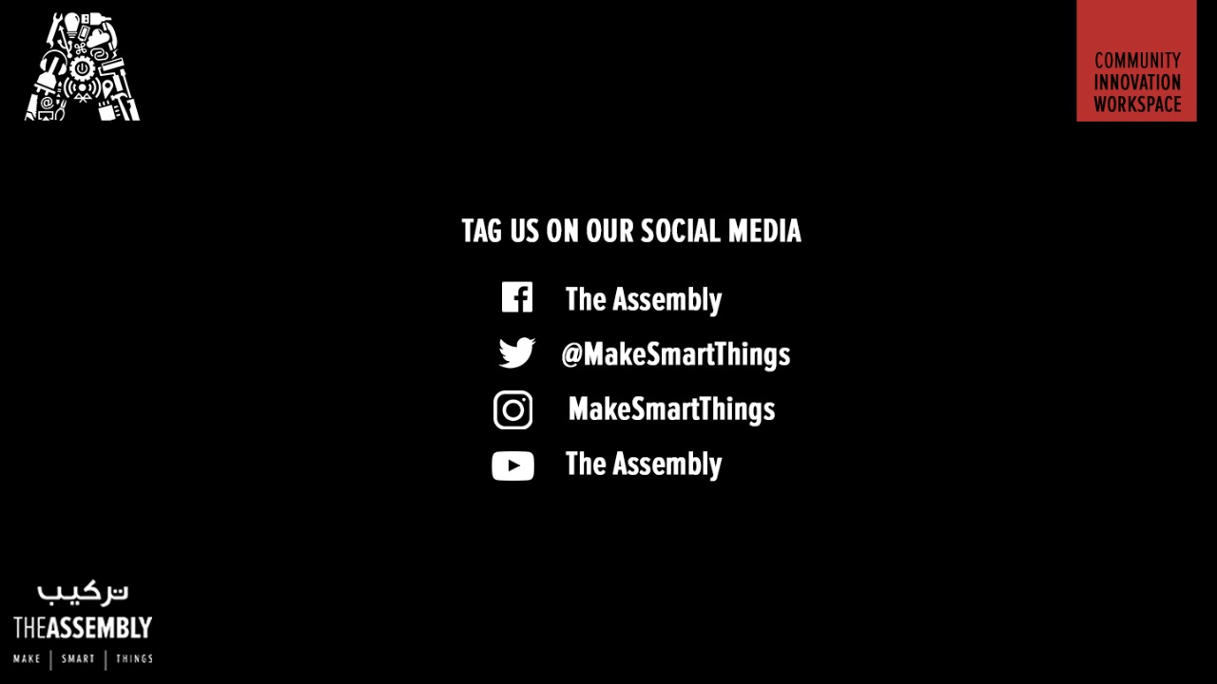
THANK YOU

